Slide 1
Crime in the City of Chicago
Steve Kinsella, Crystal Mathis,
Pamela Saborio-Rojas, Rachel Greenebaum

Slide 2
Hypothesis
Higher crime will directly impact a neighborhood’s residential real estate market.

Slide 3
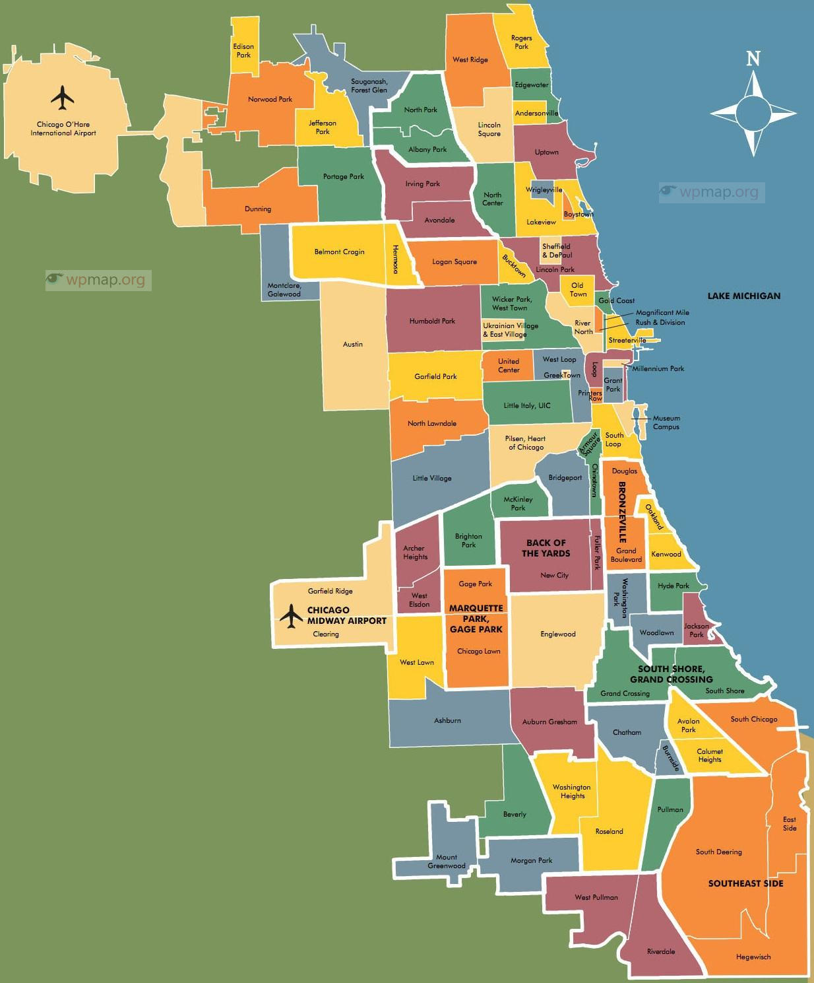
Parameters/Sources:
Neighborhoods in the City of Chicago
August 1, 2019 - August 31, 2019
RedFin for housing price data
City of Chicago for crime data
https://www.wpmap.org/map-of-chicago/chicago-neighborhood-map/
Notes:
For reference

Slide 4
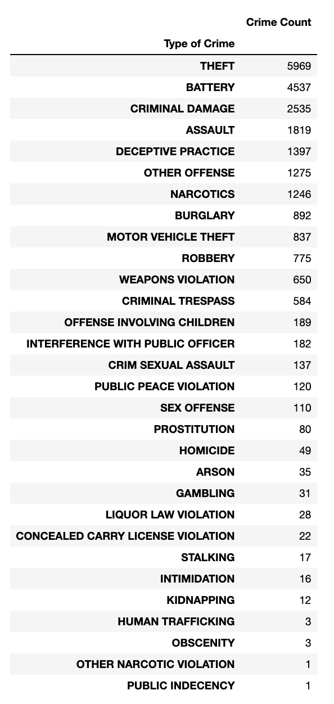
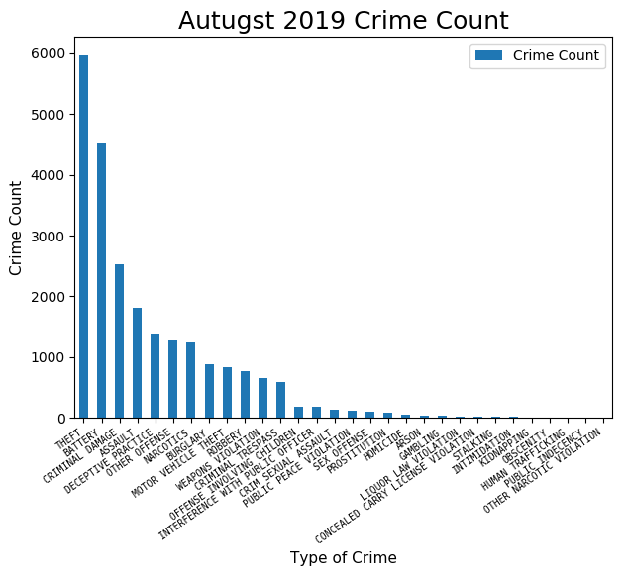
August 2019 Crime Count in Chicago Neighborhoods

Slide 5
Obstacles & Questions
Original scope Aug 18 to Aug 19; however, scope was reduced based on time and resource constraints
Dirty Data:
Over 100 neighborhoods only had 1 incident reported in August
Analysis and merge issues due to white spaces in the data
Crime and Housing data required both GPS (lat/lng) and neighborhood, but each only had one
Data may be skewed based on time of year
Housing data is from one source (Redfin)
Housing data difficult to source

Slide 6
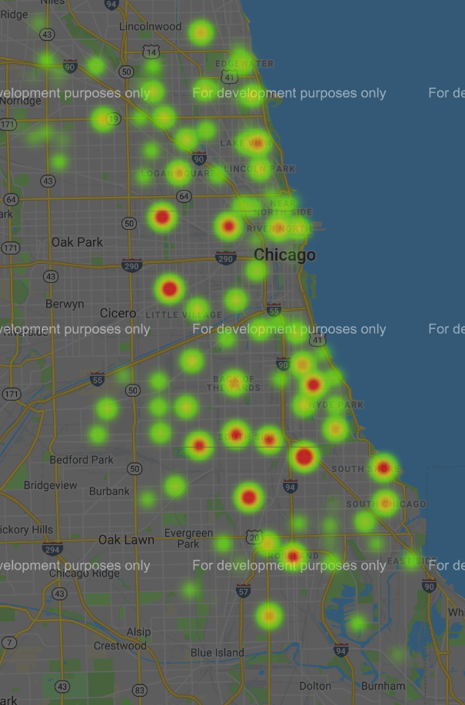
Crime Density Heatmap

Slide 7
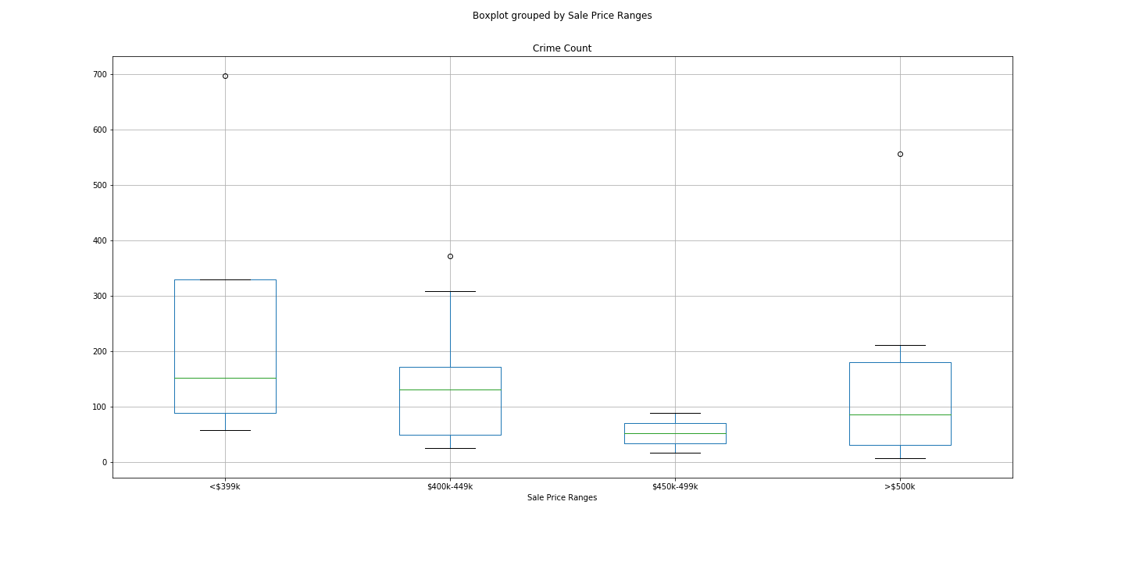
Top 25 Sale Price vs Crime Box

Slide 8
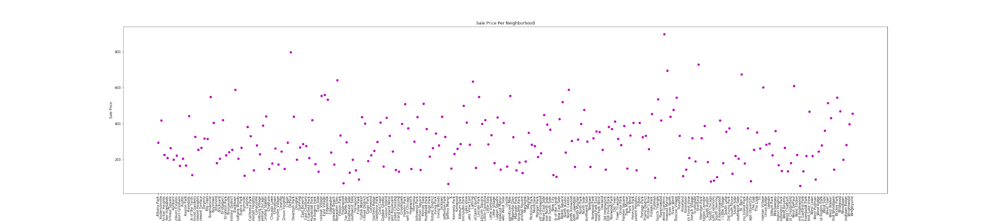
Sale price by Neighborhood

Slide 9
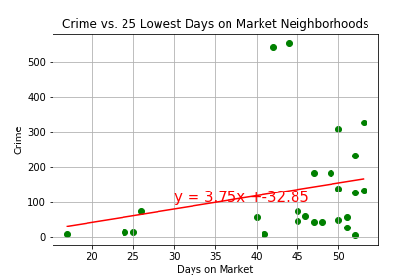
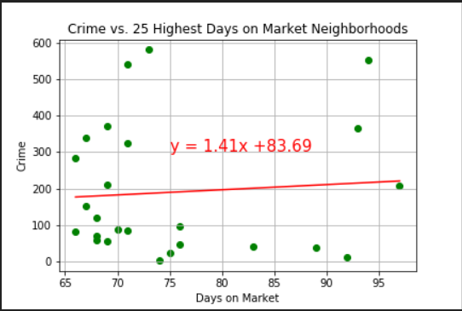
Top/Bottom 25 Days on Market

Slide 10
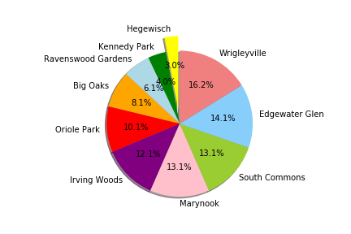
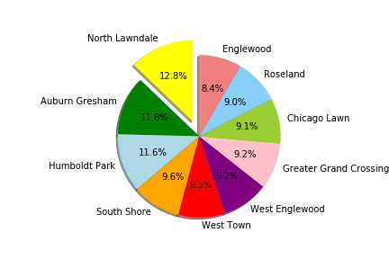
10 Lowest Crime Neighborhoods
10 Highest Crime Neighborhoods

Slide 11
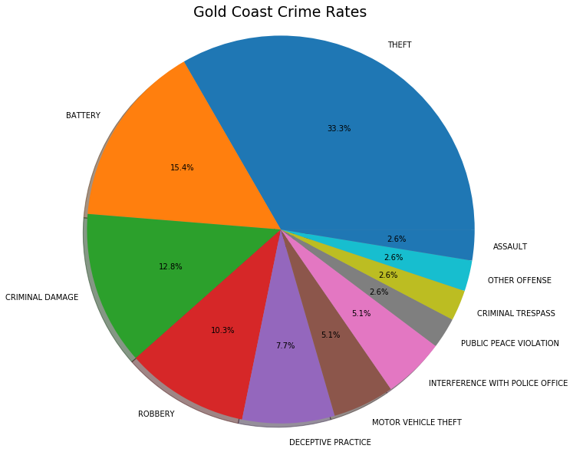
August Crime Breakdown: Gold Coast

Slide 12
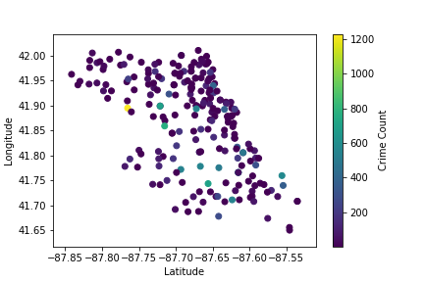
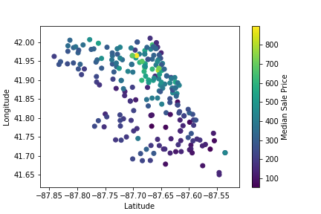
August Crime Count and Sales Price
Crime Count
Median Sale Price

Slide 13
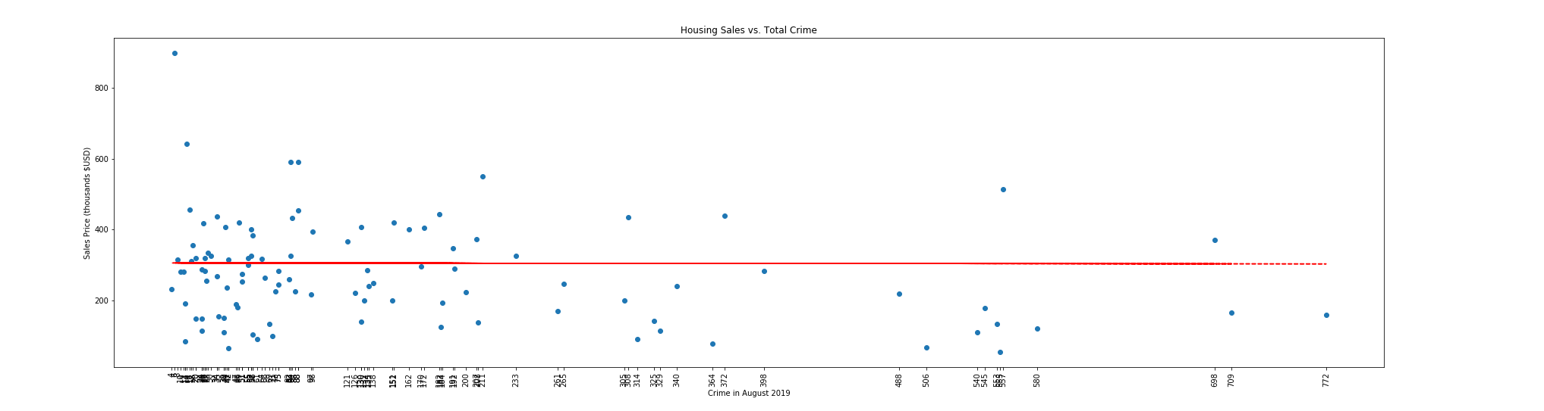
Correlation - Sales Price and Crime
The correlation between Sales Price and Crime is -0.23

Slide 14
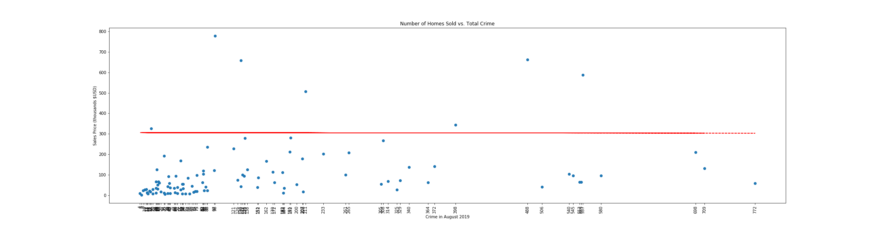
Correlation - Homes sold vs Crime
The correlation between Homes Sold and Crime is 0.29

Slide 15
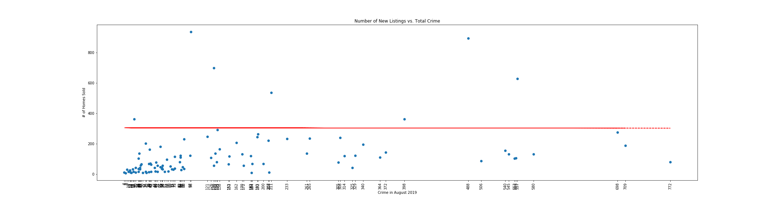
Correlation - Listings vs Crime
The correlation between New Listings and Crime is 0.34

Slide 16
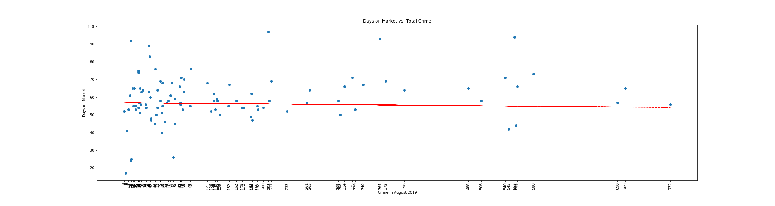
Correlation - Days on Market vs Crime
The correlation between Days on Market and Crime is 0.18

Slide 17
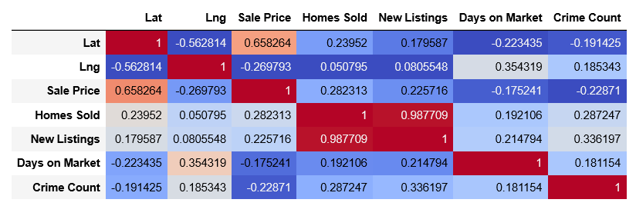
Correlation - Summary

Slide 18
Conclusions
There is no correlation between August 2019 crime data and its equivalent Redfin housing data.

Slide 19
Appendix

Slide 20
Correlation - Sales Price and Crime
The correlation between Homes Sold and Crime is 0.29

Slide 21
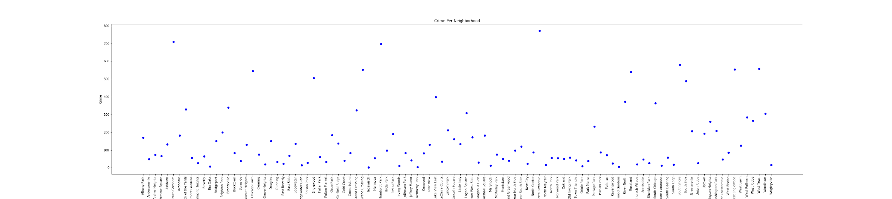

Slide 22
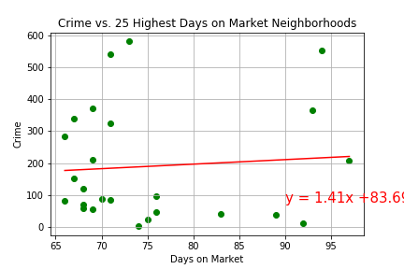
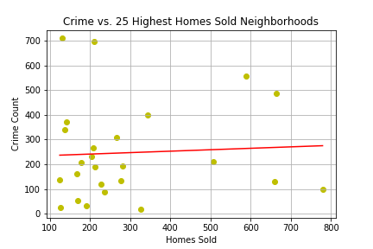
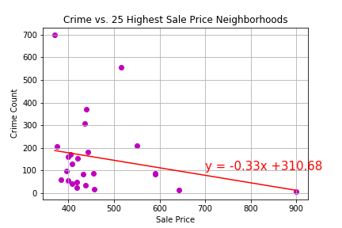
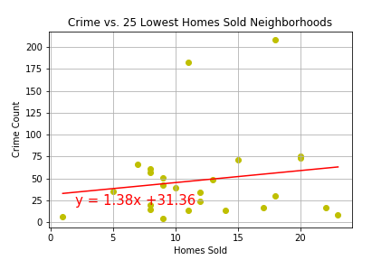
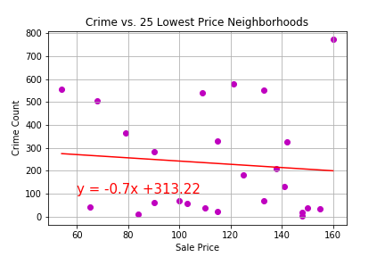

Slide 23
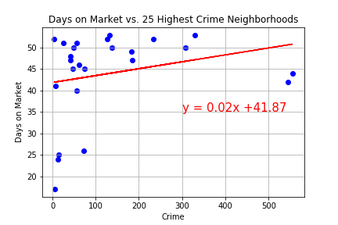
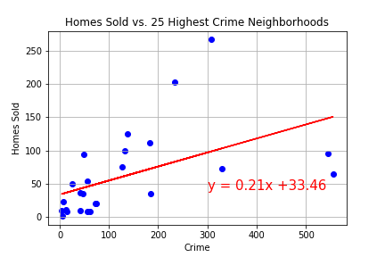
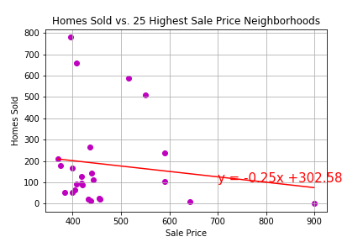
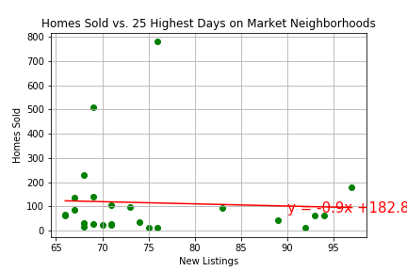
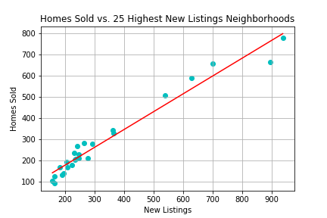
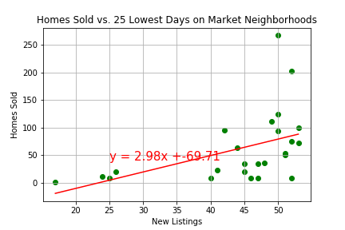

Slide 24
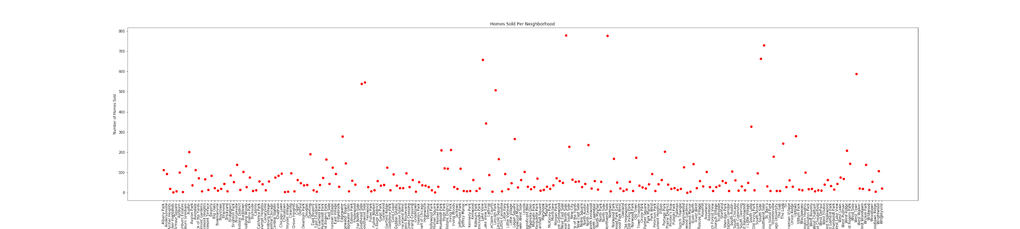
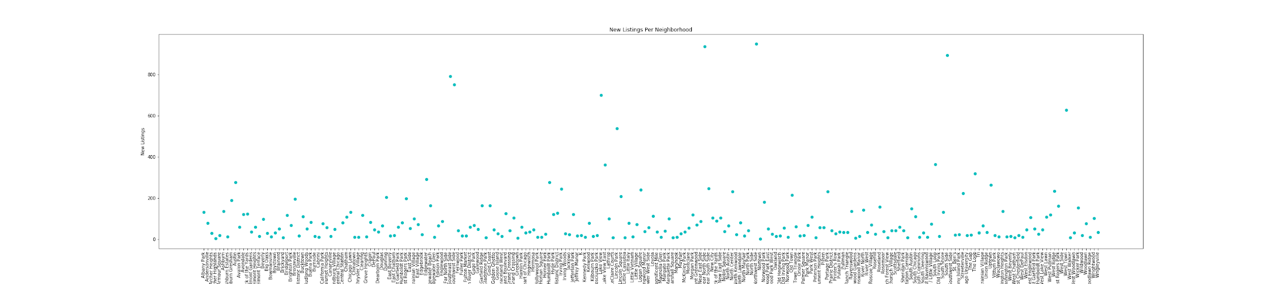

Slide 25
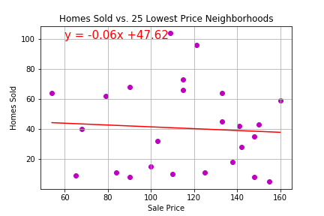
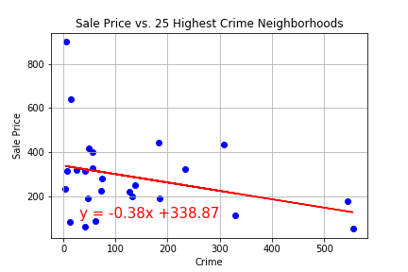
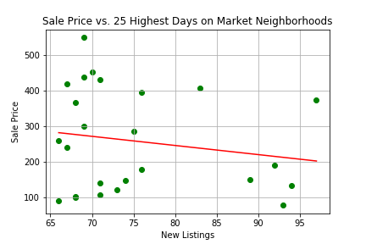
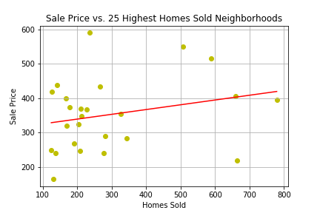
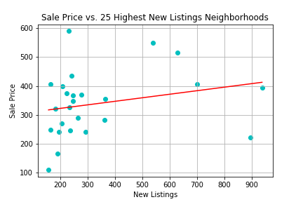
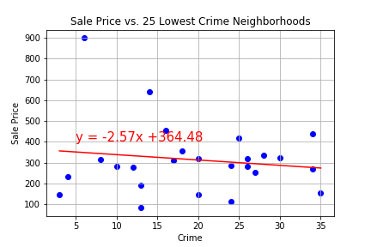

Slide 26
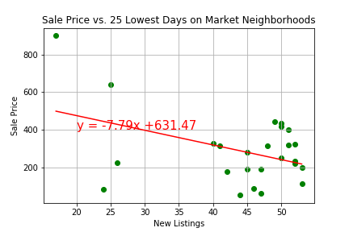
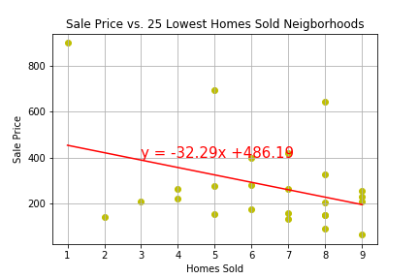
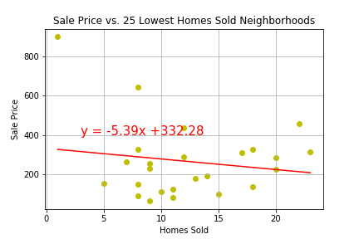

Slide 27
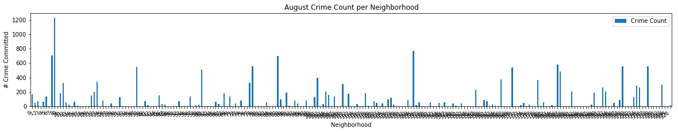
August 2019 Crime Count per Neighborhood

Slide 28
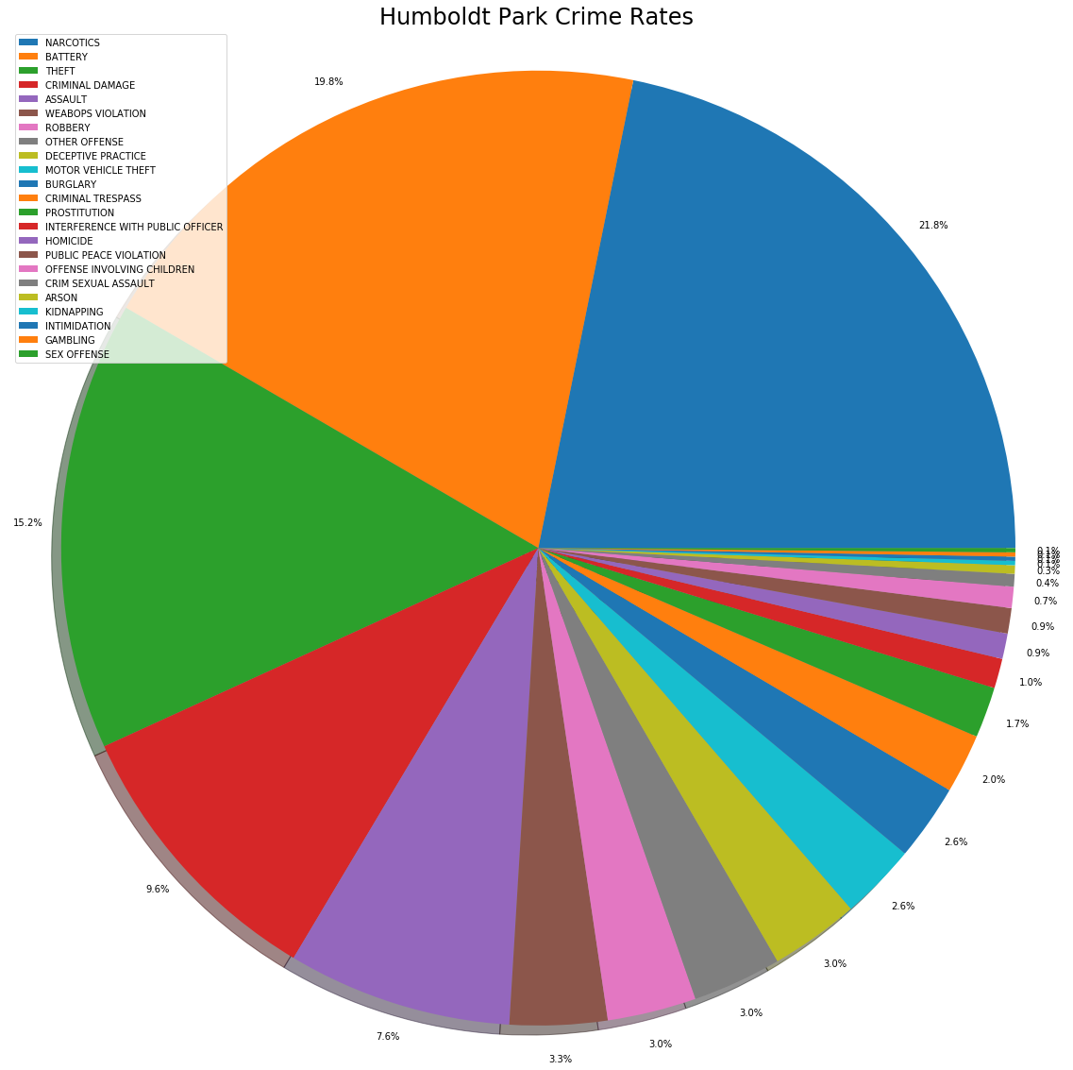
A Closer Look at Crime Type in Humboldt Park

Slide 29
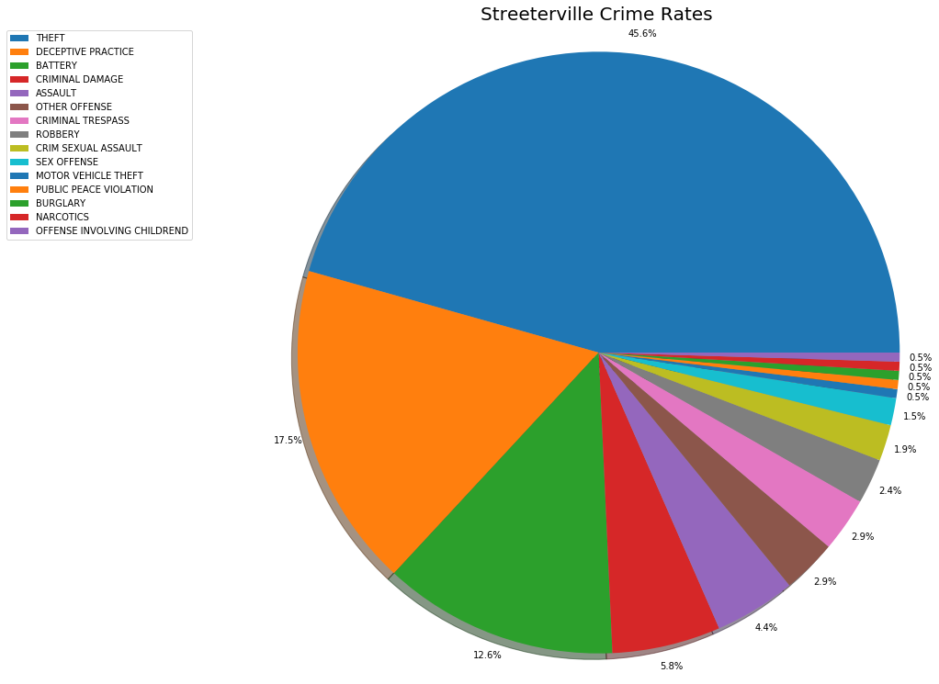
August Crime Breakdown: Streeterville

Slide 30
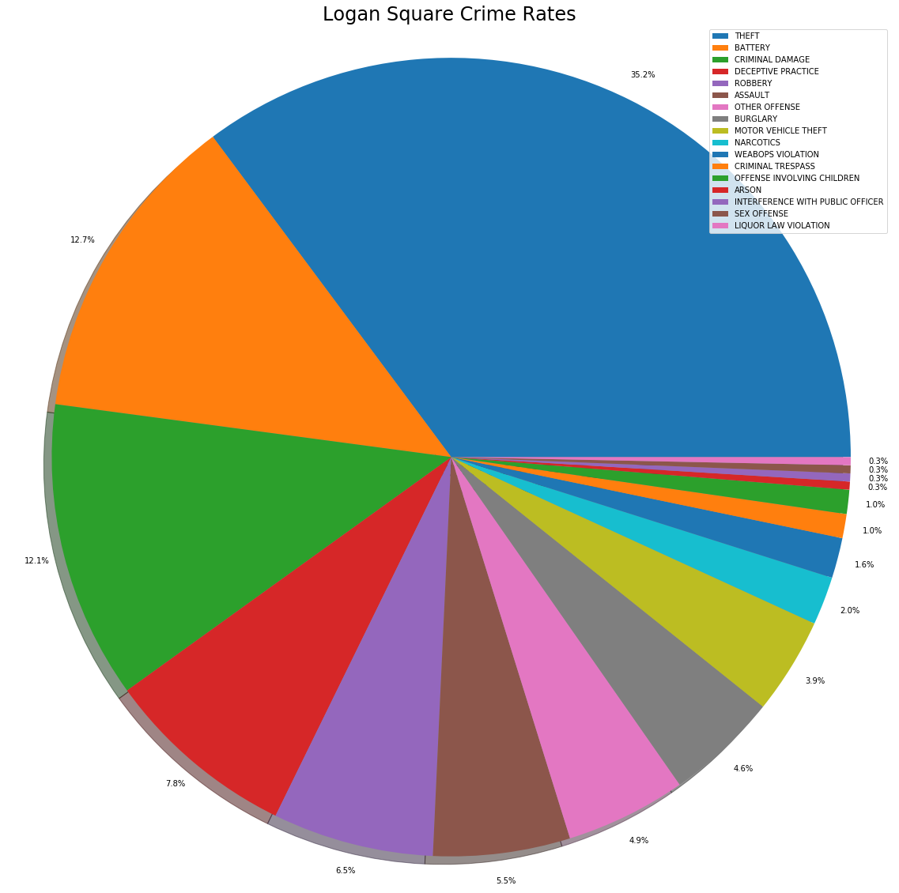
August Crime Breakdown: Logan Square

